Slide 1
Cornell Note-taking & Machine Language
Cornell Note-taking Method, Machine Languages, Control Flow of Computer Instructions, The Hack Assembly Language

Slide 2
Lecture Outline
Cornell Note-taking Method
System for Taking, Organizing, and Reviewing Notes
Machine Languages
Assembly Languages, Producing Machine Code
Control Flow of Computer Instructions
Jumps in Assembly, The Program Counter
The Hack Assembly Language
Registers, A-Instructions, Symbols, & C-Instructions

Slide 3
Recap: Bloom’s Taxonomy
Creating
Producing something new
Justifying your decisions or position
Evaluating
Drawing connections among ideas
Analyzing
Using information in a new (or similar) situation
Applying
Understanding
Explaining ideas or concepts
Remembering
Recalling facts and basic concepts

Slide 4
Cornell Note Taking Method
Questions
Notes
Main Topic
Sub point
definition
example **
Object-Oriented Programming
Encapsulates the data and the operations for a given data type
Provides abstractions - you don’t need to know how a car is implemented in order to use it
Extensibility - easier to add new data types
Functional Programming
Extensibility - easier to add new operations
Compose a question that corresponds to the notes you took
In what ways is object-oriented programming more extensible than functional programming?
Summary
Object-oriented programming and functional programming are two types of programming paradigms…

Slide 5
Cornell Note Taking Method
Questions
Notes
Main Topic
Sub point
definition
example **
Object-Oriented Programming
Encapsulates the data and the operations for a given data type
Provides abstractions - you don’t need to know how a car is implemented in order to use it
Extensibility - easier to add new data types
Functional Programming
Extensibility - easier to add new operations
Compose a question that corresponds to the notes you took
In what ways is object-oriented programming more extensible than functional programming?
Summary
Object-oriented programming and functional programming are two types of programming paradigms…

Slide 6
Applying the Cornell Note-Taking Method
Try it during today’s technical lecture!
You will have a chance to reflect on your experience taking Cornell Notes in Project 4

Slide 7
Lecture Outline
Cornell Note-taking Method
System for Taking, Organizing, and Reviewing Notes
Machine Languages
Assembly Languages, Producing Machine Code
Control Flow of Computer Instructions
Jumps in Assembly, The Program Counter
The Hack Assembly Language
Registers, A-Instructions, Symbols, & C-Instructions

Slide 8
Revisiting The Von Neumann Architecture
(This picture will get more detailed as we go!)
COMPUTER
MEMORY
CPU
PROGRAM
INPUT
OUTPUT
DATA
REGISTERS
CONTROL

Slide 9
Machine Code
Instructions are stored in memory, so they must be able to be encoded in binary
When we refer to machine code, we are typically talking about this binary representation of code
Each instruction is a sequence of 0s and 1s
Our computer / hardware specification is what gives meaning to each part of this sequence
“Is this an add or subtract instruction? What are the inputs?”

Slide 10
Storing the Program
(This picture will get more detailed as we go!)
COMPUTER
MEMORY
CPU
0
1
2
0101110011100110
1011000101010100
1110001011111100
...
Instructions
INPUT
OUTPUT
n
n+1
n+2
1100101010010101
1100100101100111
0011001010101011
...
Data
REGISTERS
CONTROL

Slide 11
Assembly Languages
Writing code using 0s and 1s is tedious and error prone
Assembly languages are a human-readable format of binary instructions that a CPU runs
Each human-readable assembly instruction has a corresponding binary machine code instruction
Example: addq reg1, reg2 == 0b1011000101010100
Assembly is often used as an intermediary between a high-level programming language and machine code

Slide 12
Producing Machine Code
while (i < 100) {
sum += arr[i];
i++;
}
Java
Compile
MEMORY
CPU
0101110011100110
1011000101010100
1110001011111100
...
Machine Code Instructions
PROGRAM
DATA
Load & Execute
REGISTERS
CONTROL
12

Slide 13
Producing Machine Code
while (i < 100) {
sum += arr[i];
i++;
}
Java
Compile
MEMORY
CPU
0101110011100110
1011000101010100
1110001011111100
...
Machine Code Instructions
PROGRAM
DATA
Load & Execute
REGISTERS
CONTROL
movq $5, %rdx
addq %rsx, %rdx
movq %rdx, %rax
ret
Assembly Language
Assemble
13

Slide 14
Producing Machine Code
while (i < 100) {
sum += arr[i];
i++;
}
Java
Compile
MEMORY
CPU
0101110011100110
1011000101010100
1110001011111100
...
Machine Code Instructions
PROGRAM
Compile
DATA
Load & Execute
REGISTERS
CONTROL
movq $5, %rdx
addq %rsx, %rdx
movq %rdx, %rax
ret
Assembly Language
Assemble
14

Slide 15
Machine Language
Specification of the Hardware / Software interface
What operations are supported?
What do they operate on?
How is the program controlled?
Usually in close correspondence with the hardware architecture
Different specification for different hardware platforms
Cost and Performance Tradeoffs
Silicon area and complexity
Time to complete instruction
Power consumption

Slide 16
Machine Operations
Correspond to the operations supported by hardware:
Arithmetic (+, –)
Logical (And, Or)
Flow Control (“go to instruction n”, “if (condition) then go to instruction n”)
Differences between machine languages:
Instruction set richness (e.g., division? bulk copy?)
Data types (e.g., word size, floating point)

Slide 17
Registers
CPU
CPU typically has a small number of registers
Very efficient to access
Used for intermediate, short-term “scratch work”
Number and use of registers is a central part of any machine language
REGISTERS
rsp
0101110011100110
reg2
0101110011100110
D
0101110011100110
CONTROL
17

Slide 18
Addressing Modes
“What locations can I specify in my assembly code?”
Some useful options:
Register
add reg1, reg2
Direct Memory Access
add reg1, Memory[200]
Indirect Memory Access
add reg1, Memory[reg2]
Immediate
add 100, reg2
Register names
Access the giant array (i.e., memory) at index 200

Slide 19
Lecture Outline
Cornell Note-taking Method
System for Taking, Organizing, and Reviewing Notes
Machine Languages
Assembly Languages, Producing Machine Code
Control Flow of Computer Instructions
Jumps in Assembly, The Program Counter
The Hack Assembly Language
Registers, A-Instructions, Symbols, & C-Instructions

Slide 20
Flow Control
COMPUTER
Which instruction should execute next?
MEMORY
CPU
0
1
2
0101110011100110
1011000101010100
1110001011111100
...
Instructions
INPUT
OUTPUT
n
n+1
n+2
1100101010010101
1100100101100111
0011001010101011
...
Data
REGISTERS
CONTROL
PC
1
20

Slide 21
Flow Control: Unconditional Jumps
Usually, the CPU just executes machine instructions in a sequence
Typically moves to the instruction with the next highest address
Sometimes we want to always “jump” to another location
Example: At the end of an infinite loop
High Level Code (similar to Java) | Assembly Code
while (true) { reg1++; <more loop body> } <code after loop> | TOP: add 1, reg1 <more loop body> jmp TOP <code after loop>

Slide 22
Flow Control: Conditional Jumps
Usually, the CPU just executes machine instructions in a sequence
Typically moves to the instruction with the next highest address
Sometimes we want to “jump” only if a condition is met
Example: At the condition of an if statement
High Level Code (similar to Java) | Assembly Code
if (reg1 < reg2) { reg1++; } reg2++; | cmp reg1, reg2 jge SKIP add 1, reg1 SKIP: add 1, reg2

Slide 23
Program Counter (PC)
Memory is used to store data as well as code
Instructions and operations are stored at different addresses in memory
Program Counter in the CPU keeps track of which address contains the instruction that should be executed next
COMPUTER
MEMORY
Data and instructions
CPU
Program Counter (which line of code should I execute)

Slide 24
Program Counter (PC)
Keeps track of what instruction we are executing
If the PC outputs 24, on the next clock cycle the computer runs the instruction at address 24 in the code segment
Next cycle, replace counter value with in
(E.g., method calls)
Next cycle, add 1 to counter value
(E.g., normal operation)
Next cycle, set counter to 0
(E.g., program start)
load
inc
reset
in
PC
out
16
16

Slide 25
Program Counter (PC)
Keeps track of what instruction we are executing
If the PC outputs 24, on the next clock cycle the computer runs the instruction at address 24 in the code segment
Program counter specification:
if (reset[t] == 1) out[t+1] = 0
else if (load[t] == 1) out[t+1] = in[t]
else if (inc[t] == 1) out[t+1] = out[t] + 1
else out[t+1] = out[t]
load
inc
reset
in
PC
out
16
16

Slide 26
Lecture Outline
Cornell Note-taking Method
System for Taking, Organizing, and Reviewing Notes
Machine Languages
Assembly Languages, Producing Machine Code
Control Flow of Computer Instructions
Jumps in Assembly, The Program Counter
The Hack Assembly Language
Registers, A-Instructions, Symbols, & C-Instructions

Slide 27
The Hack Computer
The hardware you will build
16-bit word size
ROM: sequence of instructions
ROM[0], RAM[1]…
RAM: data sequence
RAM[0], RAM[1]…
COMPUTER
MEMORY
CPU
ROM
(16-bit Instructions, Read-Only)
1110001011111100
REGISTERS
RAM
(16-bit Data, Read/Write)
1100101010010101
A/M
D
SCREEN
CONTROL
KEYBOARD
PC
27

Slide 28
The Hack Machine Language
Two types of instructions (16-bit)
A-instructions load data
C-instructions perform computations
Program: sequence of instructions
COMPUTER
MEMORY
CPU
ROM
(16-bit Instructions, Read-Only)
1110001011111100
REGISTERS
RAM
(16-bit Data, Read/Write)
1100101010010101
A/M
D
SCREEN
CONTROL
KEYBOARD
PC
28

Slide 29
Hack: Control Flow
Startup
Hack instructions loaded into ROM
Reset signal initializes computer state (instruction 0)
Execution
Usually, advance to next instruction each cycle
On jump instruction, write a different address into the PC
0
1
2
3
4
5
6
7
...
0101110011100110
1011000101010100
1110001011111100
0101110101101110
0001011000111010
0010111011011001
0110111110101001
0001110010110110
ROM (Instructions)

Slide 30
Hack: Registers
D Register: For storing Data
A Register: For storing data and Addressing memory
M “Register”: The 16-bit word in Memory currently being referenced by the address in A
RAM
1100101010010101
...
106
107
108
109
110
...
REGISTERS
M
A
108
D

Slide 31
Hack: A-Instructions
Syntax:
value can either be:
A non-negative decimal constant
A symbol referring to a constant
Semantics:
Stores value in the A register
@value

Slide 32
Hack: A-Instructions
Symbolic Syntax
Loads a value into the A register
Example:
Binary Syntax
@value
0000000000010101
Family:
A-Instruction
Value:
Binary encoding of 21
A Register
D Register
...
@21
...
0
0
A Register
D Register
21
0

Slide 33
Hack: Symbols
Symbols are simply an alias for some address
Only in the symbolic code—don’t turn into a binary instruction
Assembler converts use of that symbol to its value instead
Example:
LOOP = 02
00
01
02
03
04
@3
D=0
(LOOP)
@21
D=1
@LOOP
...
00
01
02
03
04
0000000000000011
1110101010010000
0000000000010101
1110111111010000
0000000000000010
...
Assemble

Slide 34
Hack: Built-In Symbols
Using ( ) defines a symbol in ROM / Instructions
Assembler knows a few built-in symbols in RAM / Data
R0, R1, ..., R15: Correspond to addresses at the very beginning of RAM (0, 1, …, 15)
“Virtual registers,” Useful to store variables
SCREEN, KBD: Base of I/O Memory Maps
Example:
A Register
D Register
...
@R3
...
0
0
A Register
D Register
3
0

Slide 35
Hack: C-Instructions
Syntax: (dest and jump optional)
dest is a combination of destination registers:
comp is a computation:
jump is an unconditional or conditional jump:
Semantics:
Computes value of comp
Stores results in dest (if specified)
If jump is specified and condition is true (by testing comp result), jump to instruction ROM[A]
dest = comp ; jump
M, D, MD, A, AM, AD, AMD
0, 1, -1, D, A, !D, !A, -D, -A, D+1, A+1, D-1, A-1, D+A, D-A, A-D, D&A, D|A, M, !M, -M, M+1, M-1, D+M, D-M, M-D, D&M, D|M
JGT, JEQ, JGE, JLT, JNE, JLE, JMP

Slide 36
Hack: C-Instructions
Symbolic:
Binary:
dest = comp ; jump
1 1 1 a c1 c2 c3 c4 c5 c6 d1 d2 d3 j1 j2 j3
Family:
C-Instruction
Unused
Comp:
ALU Operation (a bit chooses between A and M)
Dest:
Where to store result
Jump:
Condition for jumping

Slide 37
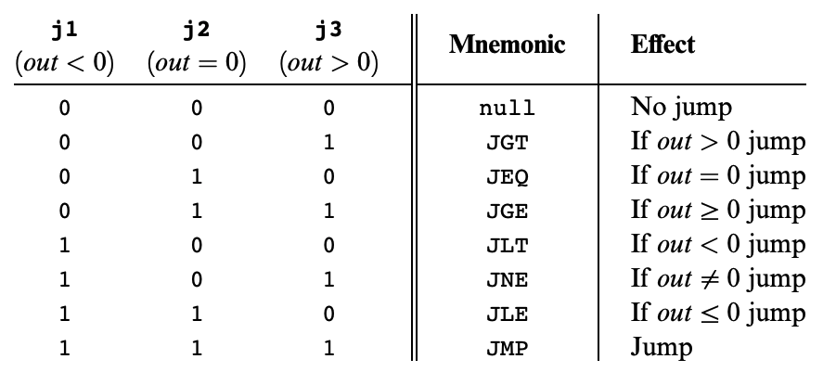
Hack: C-Instructions
Symbolic:
Binary:
dest = comp ; jump
1 1 1 a c1 c2 c3 c4 c5 c6 d1 d2 d3 j1 j2 j3
Jump:
Condition for jumping
Chapter 4

Slide 38
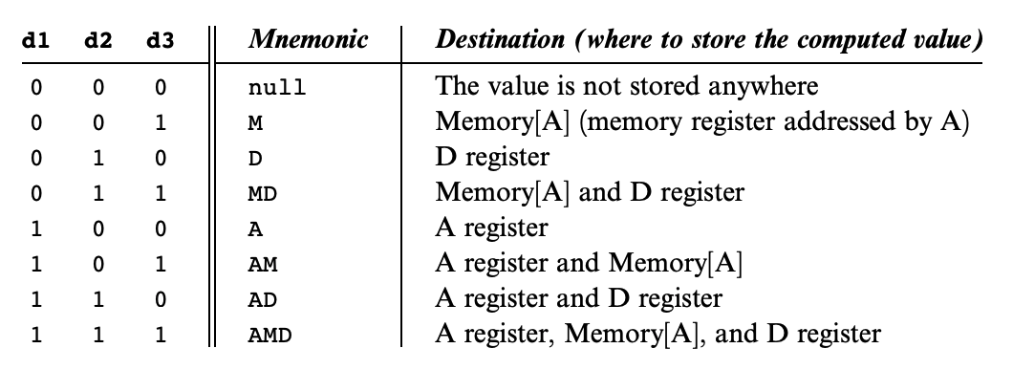
Hack: C-Instructions
Symbolic:
Binary:
dest = comp ; jump
1 1 1 a c1 c2 c3 c4 c5 c6 d1 d2 d3 j1 j2 j3
Dest:
Where to store result
Chapter 4

Slide 39
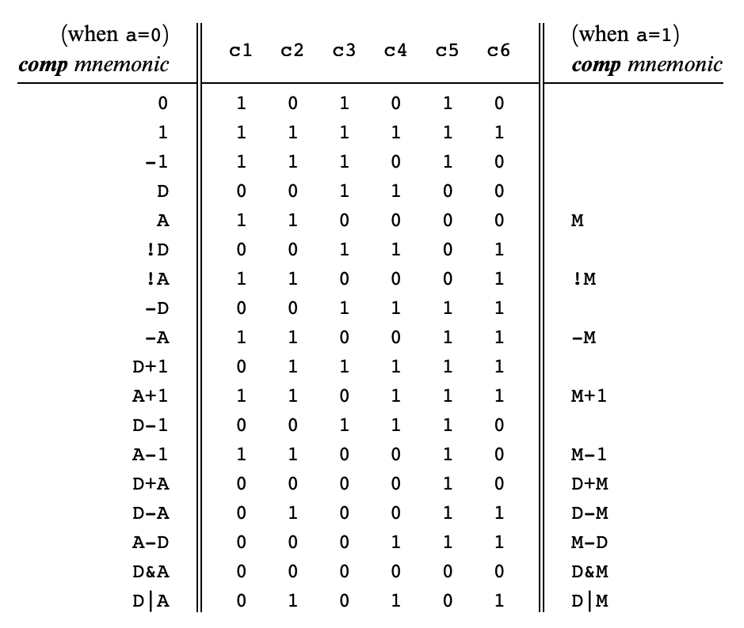
Hack: C-Instructions
Symbolic:
Binary:
dest = comp ; jump
1 1 1 a c1 c2 c3 c4 c5 c6 d1 d2 d3 j1 j2 j3
Comp:
ALU Operation (a bit chooses between A and M)
Chapter 4
Important: just pattern matching text!
Cannot have “1+M”

Slide 40
Hack: C-Instructions Example
A Register
D Register
55
56
00
01
(EXAMPLE)
@55
D=A+1

Slide 41
Hack: C-Instructions Example
A Register
D Register
55
56
00
01
02
03
(EXAMPLE)
@55
D=A+1
@R2
M=D
RAM
0
?
A Register
D Register
1
?
2
56
2
56
...

Slide 42
Hack: C-Instructions Example
A Register
D Register
55
56
00
01
02
03
04
05
(EXAMPLE)
@55
D=A+1
@R2
M=D
@EXAMPLE
D;JGT
RAM
0
?
A Register
D Register
1
?
2
56
2
56
...
A Register
D Register
0
56
(Will jump to instruction 0, since D > 0)

Slide 43
Lecture 7 Reminders
Lectures will be in CSE2 271 starting this Friday until the rest of the quarter
Project 4 due this Friday (1/26) at 11:59pm
Amy has office hours tomorrow at 1:30pm in CSE2 151
Feel free to post your questions on the Ed board as well
Midterm exam coming up in around two weeks (2/9) during lecture time
More details to come, along with metacognitive strategies for preparing for exams

